Slide 1

Retail Checkout Simulation Using Queue & Priority Queue
SOWMYA VAISHNAVI PES2UG24CS126
NIKHIL G PES2UG24CS165
H S DEEKSHA PRASAD PES2UG24CS176

Slide 2



Functions Used in the Program: An Overview
Linear Queue
Priority Queue
Express Lane Logic
Manages standard FIFO customer flow.
Optimizes service for shortest tasks first.
Simulates dynamic customer shifting for efficiency.

Slide 3
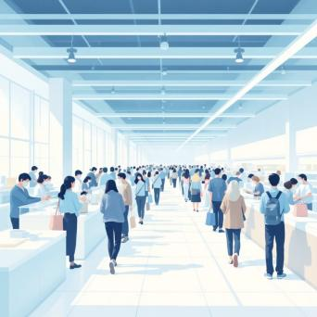
The Linear Queue
initLQ(): Initializes the queue, setting front and rear pointers to -1, preparing it for new customers.
isEmptyLQ(): A quick check to determine if the queue currently has any customers waiting.
queueLength(): Provides an exact count of customers currently present in the queue.
enqueueLQ(): Adds a new customer (represented by their service time) to the end of the line.
dequeueLQ(): Removes the customer who has been waiting the longest from the front of the queue.

Slide 4
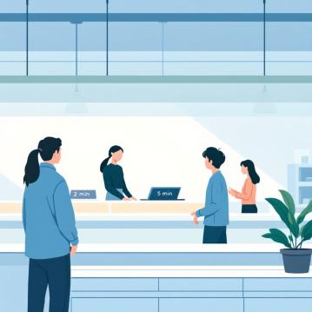
Priority Queue Functions
initPQ()
Sets the priority queue’s size to zero and prepares it for use.
swap()
Exchanges two elements inside the heap
insertPQ()
Inserts a service time and restores the min-heap order.
removePQ()
Removes the smallest service time and re-heapifies.
The Priority Queue, implemented as a min-heap, is central to applying the Shortest Job First (SJF) scheduling algorithm, prioritizing efficiency.

Slide 5

Express Lane Logic:
openExpressLane()
customerJockeys()
Identifies eligible customers (those with minimal items/service time) from the main queue and transfers them to the express lane, maintaining its "fast-track" purpose.
Balances queues by moving a customer from the longer line to the shorter one.

Slide 6

Supporting Function: calculateServiceTime()
Item-to-Time Conversion
This crucial utility function takes the number of items a customer has and converts it into a quantifiable service time in seconds.
It provides a standardized metric for queue processing across all algorithms.
Used By:
Main Queue (Linear Queue)
Express Lane Queue
Priority Queue

Slide 7
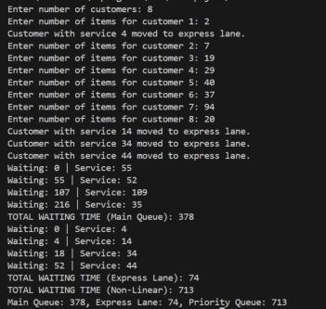
Output
Smaller-item customers benefit from faster processing, proving the express lane improves checkout efficiency.

Slide 8
THANK YOU

